Slide 1
LET’S MEET…

Slide 2
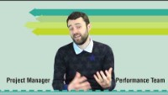
Dominic – Project Manager
Q1 What is your job title and what does it mean?

Slide 3
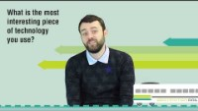
Dominic – Project Manager
Q2 What is the most interesting piece of technology you get to use?

Slide 4
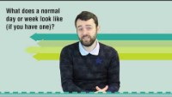
Dominic – Project Manager
Q3 What does a normal day or week look like (if you have one)?

Slide 5
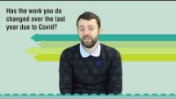
Dominic – Project Manager
Q4 Has the work you do changed over the past few months (due to COVID)?

Slide 6
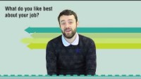
Dominic – Project Manager
Q5 What do you like best about your job?

Slide 7
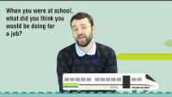
Dominic – Project Manager
Q6 When you were at high school what did you think you would be doing for a job?

Slide 8
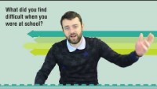
Dominic – Project Manager
Q7 What did you find difficult when you were at school?

Slide 9
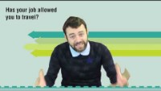
Dominic – Project Manager
Q8 Has your job allowed you to travel? Where to?

Slide 10
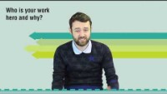
Dominic – Project Manager
Q9 Who is your work hero and why?

Slide 11
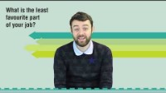
Dominic – Project Manager
Q10 What is the least favourite part of your job?

Slide 12
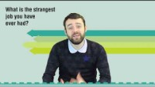
Dominic – Project Manager
Q11 What is the strangest job you have ever had?

Slide 13
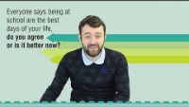
Dominic – Project Manager
Q12 Everyone says being at school are the best days of your life, do you agree or are you having a better time now?

Slide 14
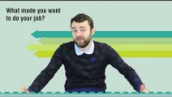
Dominic – Project Manager
Q13 What made you want to do your job?

Slide 15
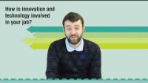
Dominic – Project Manager
Q14 How is innovation and technology involved in your job?

Slide 16
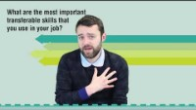
Dominic – Project Manager
Q15 What are the most important transferable skills that you use in your job?

Slide 17
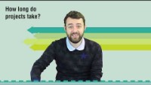
Dominic – Project Manager
BONUS: How long do projects take?

