Slide 1
Welcome!

Slide 2
Joining us today
For the 2022 – 2023 programme we have…
Some schools who have been taking part in the Robotics Challenge for a number of years!
Some new schools or teachers who have signed up for this first time this year!
Some schools who just want to find out a bit more information about the Robotics Challenge to see if they want to sign up!

Slide 3
1. Introduction to the challenge and the team 2. Getting started 3. The Challenge 4. Timeline 5. Questions

Slide 4
The UK needs more Engineers!
Aim of the programme
Our work focusses on bringing young people onto engineering pathways, changing career aspirations and improving current under-representation of women, those with special educational needs or disabilities, and young people from certain ethnic minority or low socio-economic backgrounds.
We aim to highlight the different routes into engineering and to help create a diverse and inclusive engineering workforce, reflective of the UK population.

Slide 5
Introduction and with thanks to our Sponsors
Led by
In partnership with
Evaluation of the EEP Robotics Challenge is important so we can improve the challenge and to continue securing funding!

Slide 6
Delivery partners:
Technical Support

Slide 7
What is the robotics challenge
Team based competition
Students aged 11-14 ( year 7-9)
Take on a series of robotics challenges
Attend a regional heat event

Slide 8
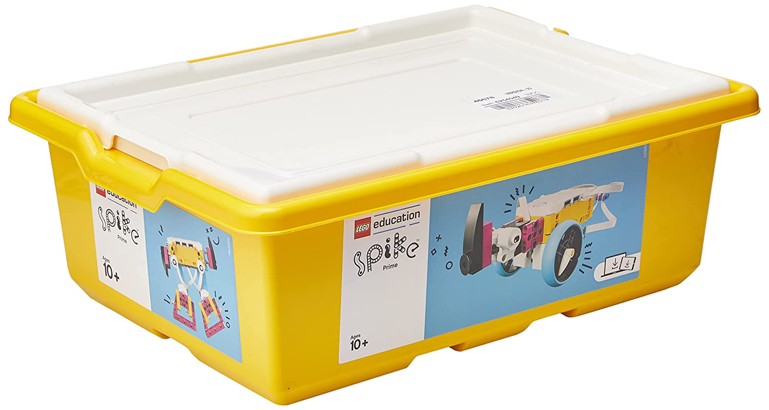
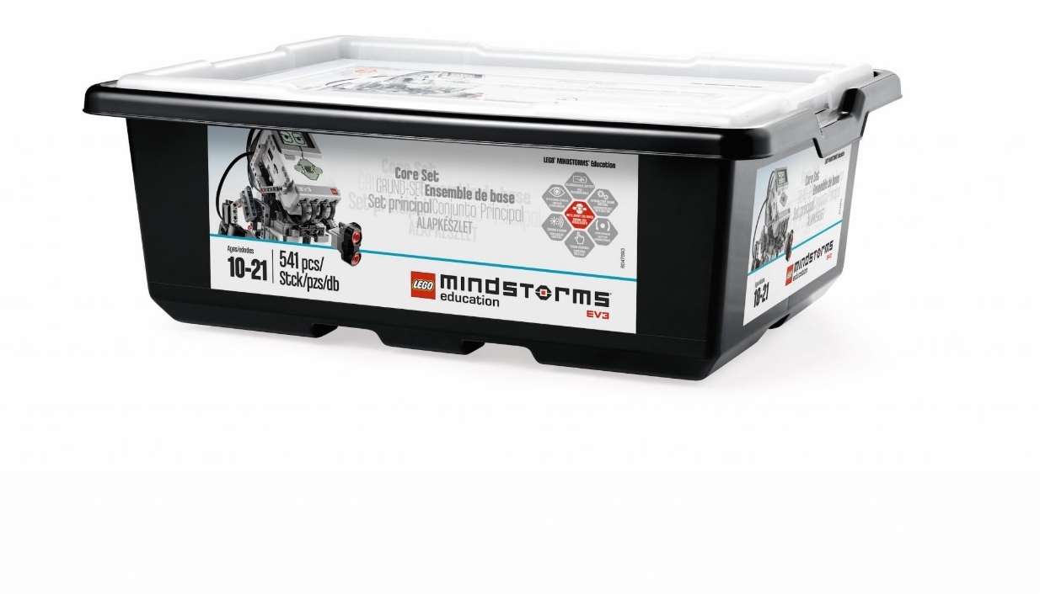
What do you need? – Kit
You will need either of the following to take part
Lego Spike Prime
2020 onwards
Lego EV3 Mindstorms
Pre - 2020
Notes:
If you don’t have a Spike Prime or Mindstorms Robot in School already, you will have to purchase one to take part in the Challenge!
Engineering UK will not be giving out new robots this year.
Historically Engineering UK did give out Mindstorms Robots to Schools who originally signed up to the program, so if your school has taken part previously you may have a robot in school already!
Spike Primes are fantastic pieces of Equipment that can be used throughout the School Year, more information on the link below.
https://education.lego.com/en-us/products/lego-education-spike-prime-set/45678#in-the-box

Slide 9
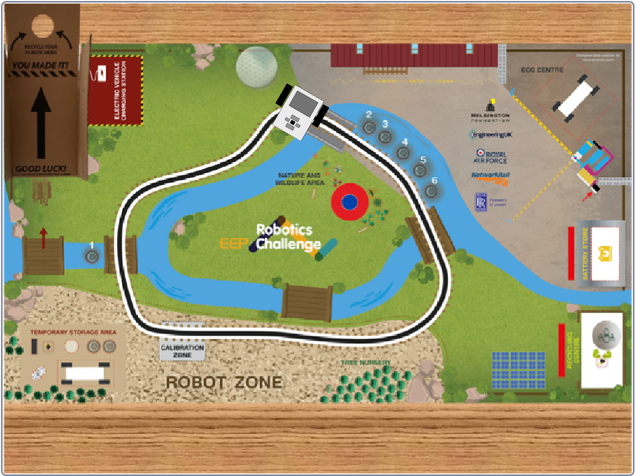
What do you need? – Kit
Challenge Matt
Provided by Engineering UK to any new schools
Notes:
Engineering UK will have a new form for you to fill this year to request replacements and new kit needed for the program! (more information will be sent out regarding this soon!)
The kit for new schools will include, Challenge Mat, Lego Pieces and Ramp!
A complete guide to how to set up your Challenge Mat and associated pieces is on the following link: ROBOTICS CHALLENGE - RAISING ROBOTS - AUTHORISED LEGO® EDUCATION PARTNER

Slide 10
What do you need? – Software
Spike Prime software
Lego Mindstorms software
Notes:
Download the LEGO MINDSTORMS Software
https://education.lego.com/en-gb/downloads/mindstorms-ev3/software
Review downloadable resources on the Robotics Challenge website
https://robotics.tomorrowsengineers.org.uk/teacher-zone/resources/
Go to the Raising Robots website to review videos and extra support materials for the Robotics Challenge https://raisingrobots.com/challenge/

Slide 11
Getting Started

Slide 12
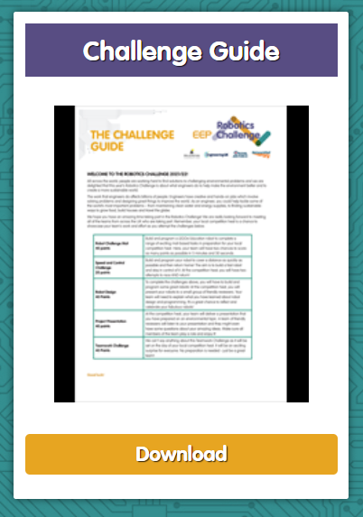
Read the Challenge Guide
Run a Teacher Led Taster Session
Set up a club
Notes:
Download the challenge guide here https://roboticschallenge.org.uk/teacher-zone/

Slide 13
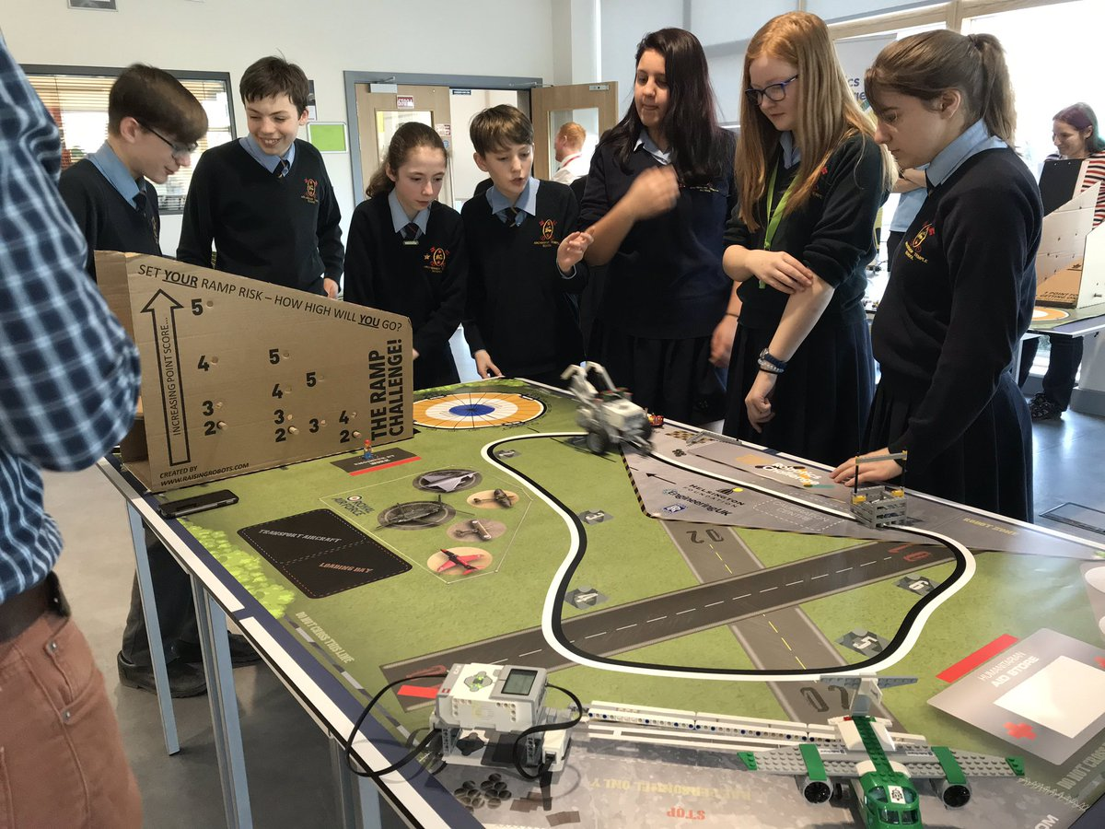
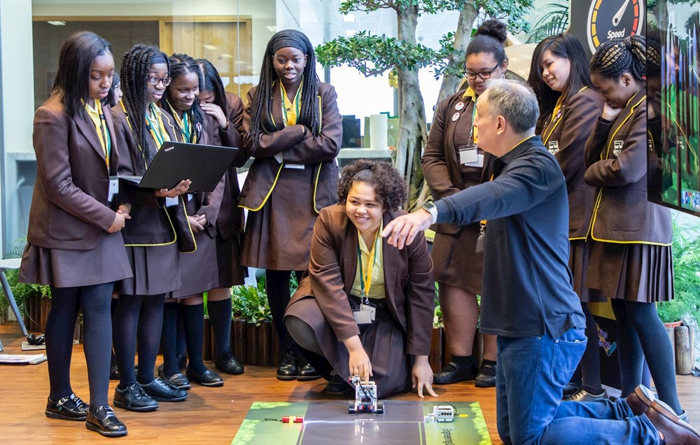
Setting up the Club
10 students per school can attend a competition heat
Ideas include:
Running it as an eco or environmental club (rather than a STEM or robotics club)
Inviting specific pupils (FSM recipients, ethnic minority students, students with a disability or special educational need, LGBTQ+ students)
Running sessions during class/curriculum time for mixed/lower ability classes
We ask that at least 50% of participants from co-ed schools identify as female.
Notes:
When setting up your team of up to 10 aged between 11-14, we ask you to consider how you will recruit students who are under-represented in engineering.
If you have more than ten students interested in taking part, you can run an in school competition and decide which team will represent your school at the heats!
Ideas include:
Running it as an eco or environmental club (rather than a STEM or robotics club)
Inviting specific pupils (FSM recipients, ethnic minority students, students with a disability or special educational need, LGBTQ+ students)
Running sessions during class/curriculum time for mixed/lower ability classes
We ask that at least 50% of participants from co-ed schools identify as female.

Slide 14
Staying on Track
New teacher resources coming soon
Teacher training and webinars
Monthly newsletters with tips and reminders

Slide 15
Participation for 2022-23!
We would love to see you all at competition heats!
If you end up being unable to attend we will need one of the following:
Send pictures or video’s of your students using your kit in school!
Fill in an evaluation to tell us how your students have been impacted by the Robotics Challenge!
This information helps us to continue to the run the programme each year!

Slide 16
Please tweet about your Robotics Challenge:
@Tomorrows_Eng
#EEPRoboticsChallenge
@RaisingRobots
#EEPRoboticsChallenge
@ByDesignGroup
#EEPRoboticsChallenge

Slide 17
The Challenge

Slide 18
The Challenge Elements!
Speed and Control Challenge: Robot travels over 4m and back again as fast as it can!
Robot Challenge Mat (8 mat based tasks): More on the next slide!
Robot Design Presentation: Your students will nee to explain to Judges why they have built their robot the way that they have!
Teamwork Challenge: On the day mystery activity

Slide 19
A. Speed and Control Challenge
Robot travels over 4m and back again as fast as it can! Add best time into Robot and Speed Challenge PPT.

Slide 20
B. Robot Challenge Mat – The 8 Tasks
Task A: Robot Showtime Program your robot to present a 30 second environmental message!
Task B: More Trees Please Program your robot to ‘plant’ the tree in the target area of the nature & wildlife area.
Task C: Pollution Clean Up Collect the two discarded TYRES that will have been placed on two of the 6 marked areas of the mat
Task D: Retrieve The Eco Vehicle You need to get your eco vehicle back to the robot zone. it is currently secured behind the security gate in the eco centre.
Task E: Battery Store
The battery for your eco vehicle is in the battery store (inside the structure you built) and you need to get it back to the robot zone.
Task F: Recycling Centre Program your robot to go to the recycling centre and retrieve both the ‘plastic’ (ping pong ball) and the engineer and then return them to the robot zone
Task G: Charge Up The Eco Vehicle You need to get your amazing eco vehicle charged up at the charging station but it needs to be taken there by your robot
Task H: The Ramp Recycler
You need to program your robot to climb the ramp recycler, starting from the robot zone.
5 minutes to complete a many as possible.
Best score from 2 attempts is counted.
Notes:
More information on ROBOTICS CHALLENGE - RAISING ROBOTS - AUTHORISED LEGO® EDUCATION PARTNER

Slide 22
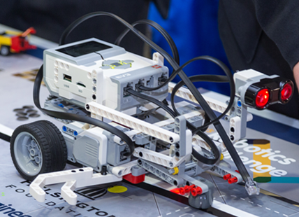
C. Robot Design Presentation
Presentation on the robot builds and programming solutions for Speed and Robot Challenges. An opportunity to highlight how robots can be used to help the world.
There is no longer a separate research based project presentation
Notes:
Your team works together to explain the thinking behind your robotic creations
As Robotics Engineers, you have designed and developed amazing robots by continuously testing, evaluating, tinkering and improving them so that your robots can complete the Speed and Robotics Challenge tasks
Our STEM Ambassadors will review your brilliant designs and solutions you’ve come up with. Good luck!

Slide 23
The Heats!
The Heats will be taking place across England, Scotland, Wales and Northern Ireland.
At learn by Design we look after heats taking place in England and Wales except the Northwest of England.
Your team does not have to have completed everything to come to a heat!
Just come along and show us what you have done, you will learn so much and have so much fun!
Look out for our heats sign up e-mail and register for a ticket for your team!
Once you have registered, we may need extra details from you before you come to the event (Car Registration, DBS information, Student and Teacher Names etc.)
Please look out for any extra e-mails regarding the heat you have signed up to!

Slide 24
Evaluation
Evaluation of the EEP Robotics Challenge is important so that we can get an understanding of how well we are doing, and so that we can learn from your feedback and improve the Challenge in future years.
What we will evaluate:
Anonymous student participation demographic data Student experience of taking part in the EEP Robotics Challenge
Teacher experience of taking part in the EEP Robotics Challenge
Your feedback is very important to us!

Slide 25
Timeline

Slide 26
Timeline
Sept – Dec
Set up your team
Join teacher training
General robot fun
Jan – Feb
Register for a heat
Start focusing on completing the robot challenges
March
Final preparation
Complete info and organize transport for the heats
April – May
Take your team along to a competition heat
June
National final at the Big Bang Fair

Slide 27
Questions?
roboticschallenge@bydesign-group.co.uk

