Slide 1
LET’S MEET…

Slide 2
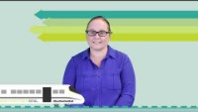
Maria – Asset Engineer
Q1 What is your job title and what does it mean?

Slide 3
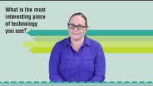
Maria – Asset Engineer
Q2 What is the most interesting piece of technology you get to use?

Slide 4
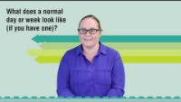
Maria – Asset Engineer
Q3 What does a normal day or week look like (if you have one)?

Slide 5
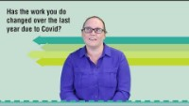
Maria – Asset Engineer
Q4 Has the work you do changed over the past few months (due to COVID)?

Slide 6
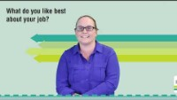
Maria – Asset Engineer
Q5 What do you like best about your job?

Slide 7
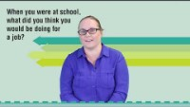
Maria – Asset Engineer
Q6 When you were at high school what did you think you would be doing for a job?

Slide 8
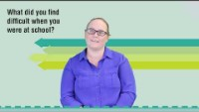
Maria – Asset Engineer
Q7 What did you find difficult when you were at school?

Slide 9
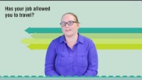
Maria – Asset Engineer
Q8 Has your job allowed you to travel? Where to?

Slide 10
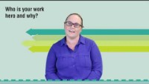
Maria – Asset Engineer
Q9 Who is your work hero and why?

Slide 11
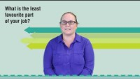
Maria – Asset Engineer
Q10 What is the least favourite part of your job?

Slide 12
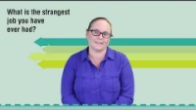
Maria – Asset Engineer
Q11 What is the strangest job you have ever had?

Slide 13

Maria – Asset Engineer
Q12 Everyone says being at school are the best days of your life, do you agree or are you having a better time now?

Slide 14
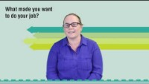
Maria – Asset Engineer
Q13 What made you want to do your job?

Slide 15
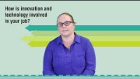
Maria – Asset Engineer
Q14 How is innovation and technology involved in your job?

Slide 16
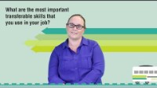
Maria – Asset Engineer
Q15 What are the most important transferable skills that you use in your job?

Slide 17
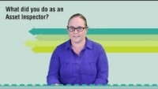
Maria – Asset Engineer
BONUS: In your previous job as an Asset Inspector, what did you do?

